Slide 1
NMAP FOR NETWORK SCANNING
Presented by: karthikayan yogi
Project Id: PTID-CHE-APR-25-123

Slide 2

Introduction to Nmap: Network Scanning
Nmap (Network Mapper) is a free, open-source tool widely used for network exploration and security auditing. It helps administrators perform tasks such as network inventory, service monitoring, and upgrade planning. Nmap identifies active hosts, running services (along with versions), operating systems, and firewall types by sending specially crafted IP packets. It is effective for both large networks and individual hosts, and is available across all major operating systems with both command-line and graphical interfaces. The chapter also touches on legal considerations, risks of misuse (like crashing systems), and Nmap’s open-source licensing under the GNU GPL.

Slide 3




Phases of an Nmap Scan:
Nmap scans operate in a sequence of well-defined phases, each contributing to the overall goal of collecting actionable network intelligence:
Host Discovery
Identifies live hosts on a network using ping and probes.
Port Scanning
Detects open ports and services running on target machines.
Service & OS Detection
Determines services, versions, and operating system fingerprinting.

Slide 4



Target Enumeration
Nmap processes the input targets (IP addresses, DNS names, or ranges) to build a list of hosts to scan.
Version Detection
If ports are open, Nmap uses probes to determine the software and version running on the services (-sV).
Script Scanning
Most NSE (Nmap Scripting Engine) scripts run during this phase to detect vulnerabilities, gather service info, or scan for malware

Slide 5
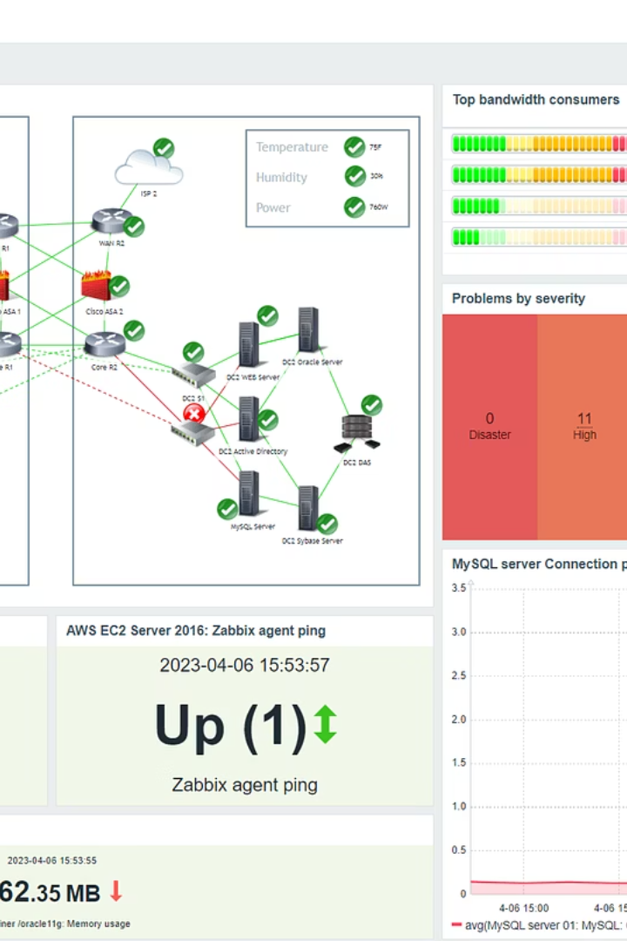
Host Discovery (Ping Scanning)
Specifying Target Hosts and Network
Host Discovery Controls
• List Scan (-sL) • Disable Port Scan (-sn) • Disable Ping (-Pn)
• Input from List (-iL)
• Random Target Selection (-iR)
• Excluding Targets(--exclude)

Slide 6
What Is Port Scanning?
Definition
Popular Ports
Why Scan Ports?
While Nmap has grown in functionality over the years, it began as an efficient port scanner, and that remains its core function. The simple command nmap scans the most commonly used 1,000 TCP ports on the host , classifying each port into the state open, closed, filtered, unfiltered, open/filtered, or closed/filtered..
HTTP (80)
To find open doors for services and potential vulnerabilities.
HTTPS (443)
FTP (21)
Port scanning serves as a critical cybersecurity practice, primarily aimed at improving network security. It helps identify open ports and unnecessary or vulnerable services that could be exploited by attackers.
SSH (22)
DNS(53)
SMTP(25)

Slide 7
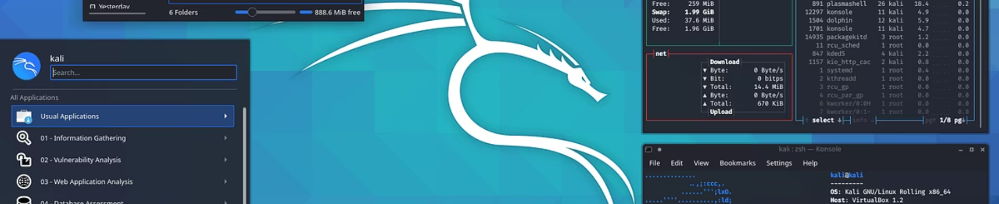
Implementing Nmap on Kali Linux
1
Step 1: Open Kali Terminal
2
Step 2: Access Nmap Help
3
Step 3: Basic TCP Scan
Launch the terminal to start commands.
Use nmap -h to learn command options.
Scan target with TCP SYN scan using nmap -sT <IP>.

Slide 8

Advanced Nmap Scan Techniques
1
Step 4: Basic UDP Scan
Run UDP scan with nmap -sU to find UDP services.
2
Step 5: Single Port Scan
Target a specific port with nmap -p .

Slide 9

Conclusion
We explored multiple scanning techniques including host discovery, TCP and UDP scans, single port scans, and subnet-wide scans, all performed through a practical environment using Kali Linux. These exercises highlighted the effectiveness of Nmap’s command-line versatility and its support for advanced options like service/version detection and scripting via NSE (Nmap Scripting Engine). These capabilities allow professionals to tailor scans precisely to their security and administrative needs.

Slide 10

Nmap’s real-world utility lies in its ability to
• Identify live systems and open ports
• Determine the services and operating systems in use
• Assess the risk surface of a network
• Aid in vulnerability discovery and penetration testing
• Support compliance checks and forensic investigations

Slide 11

Thank You
BATCH : cyber security FEB-3-2025 #6
PROJECT ID : PTID-CHEAPR-25-123.

